Slide 1
Operating Systems
Deadlock Avoidance

Slide 2
Deadlock Avoidance
Requires that the system has some additional a priori information available.
Simplest and most useful model requires that each process declare the maximum number of resources of each type that it may need
The deadlock-avoidance algorithm dynamically examines the resource-allocation state to ensure that there can never be a circular-wait condition
Resource-allocation state is defined by the number of available and allocated resources, and the maximum demands of the processes

Slide 3
Deadlock Avoidance – Safe State
A state is safe if the system can allocate resources to each process (up to its maximum) in some order and still avoid a deadlock.
More formally, a system is in a safe state only if there exists a safe sequence.
System is in safe state if there exists a sequence <P₁, P₂, …, P_{n}> of ALL the processes in the systems such that for each P_{i}, the resources that P_{i} can still request can be satisfied by currently available resources + resources held by all the P_{j}, with j < i
That is:
If P_{i} resource needs are not immediately available, then P_{i} can wait until all P_{j} have finished
When P_{j} is finished, P_{i} can obtain needed resources, execute, return allocated resources, and terminate
When P_{i} terminates, P_{i +1} can obtain its needed resources, and so on

Slide 4
Deadlock Avoidance – Safe State
If a system is in safe state ⇒ no deadlocks
If a system is in unsafe state ⇒ possibility of deadlock
Avoidance ⇒ ensure that a system will never enter an unsafe state

Slide 5
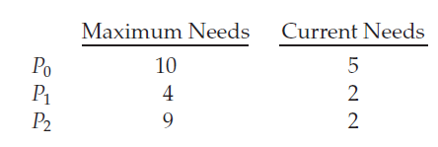
Deadlock Avoidance – Safe State
Consider we have 3 processes P0, P1 and P2 and we have 12 Magnetic tapes.
At time t0, P0 is holding 5, p1 holding 2, p2 holding 2 tape drives respectively.
The resource allocation should be done in the order of p1,p0,p2 to keep system in safe state.

Slide 6
Deadlock Avoidance Algorithms
Single instance of a resource type
Use a resource-allocation graph
Multiple instances of a resource type
Use the banker’s algorithm

Slide 7
Resource Allocation Graph Algorithm
Resource allocation graph has processes, resources, request edge and assignment edge.
In addition to this, we introduce a new edge, called a claim edge.
A claim edge Pi → Rj indicates that process Pi may request resource Rj at some time in the future.
This is represented in the graph by a dashed line.
When process Pi requests resource Rj, the claim edge Pi → Rj is converted to a request edge.
Similarly, when a resource Rj is released by Pi, the assignment edge Rj → Pi is reconverted to a claim edge Pi → Rj.
The resources must be claimed a priori in the system. That is, before process Pi starts executing, all its claim edges must already appear in the resource-allocation graph

Slide 8
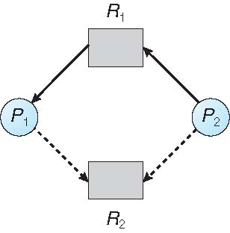
Resource Allocation Graph Algorithm
Now suppose that process Pi requests resource Rj. The request can be granted only if converting the request edge Pi → Rj to an assignment edge Rj → Pi does not result in the formation of a cycle in the resource-allocation graph.
We check for safety by using a cycle-detection algorithm.
If no cycle exists, then the allocation of the resource will leave the system in a safe state. If a cycle is found, then the allocation will put the system in an unsafe state

Slide 9
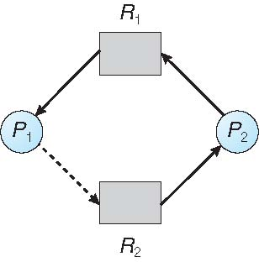
Resource Allocation Graph Algorithm
Suppose that P2 requests R2. Although R2 is currently free, we cannot allocate it to P2, since this action will create a cycle in the graph.
A cycle, as mentioned, indicates that the system is in an unsafe state. If P1 requests R2, and P2 requests R1, then a deadlock will occur.

Slide 10
Banker's Algorithm
Suitable for resources with multiple instances.
When a new process enters the system, it must declare the maximum number of instances of each resource type that it may need.
This number may not exceed the total number of resources in the system.
When a user requests a set of resources, the system must determine whether the allocation of these resources will leave the system in a safe state.
If it will, the resources are allocated; otherwise, the process must wait until some other process releases enough resources.

Slide 11
Banker's Algorithm
Let n = number of processes, and m = number of resources types
Available: Vector of length m. It indicates the number of available resources of each type. If available [j] = k, there are k instances of resource type R_{j} available
Max: n x m matrix defines the maximum demand of each process.. If Max [i,j] = k, then process P_{i} may request at most k instances of resource type R_{j}
Allocation: n x m matrix defines the number of resources of each type currently allocated to each process.. If Allocation[i,j] = k then P_{i} is currently allocated k instances of R_{j}
Need: n x m matrix. indicates the remaining resource need of each process. If Need[i,j] = k, then P_{i} may need k more instances of R_{j} to complete its task. Need [i,j] = Max[i,j] – Allocation [i,j]

Slide 12
Banker's Algorithm
Safety Algorithm
1. Let Work and Finish be vectors of length m and n, respectively. Initialize Work = Available and Finish[i] = false for i = 0, 1, ..., n − 1.
2. Find an index i such that both
a. Finish[i] == false
b. Needi ≤ Work
If no such i exists, go to step 4.
3. Work = Work + Allocation
Finish[i] = true
Go to step 2.
4. If Finish[i] == true for all i, then the system is in a safe state.

Slide 13
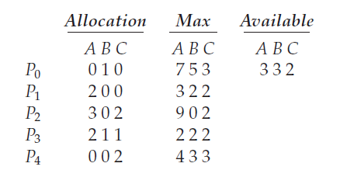
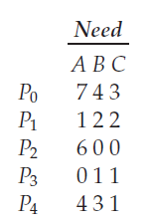
Banker's Algorithm
Example
Processes – P0,P1,P2,P3,P4 and Resources A=10, B=5, C=7.
The content of the matrix Need is defined to be Max − Allocation

Slide 14
Banker's Algorithm
Processes | Allocation | Max | Available | Need
 | A B C | A B C | A B C | A B C
P0 | 0 1 0 | 7 5 3 | 3 3 2 | 7 4 3
P1 | 2 0 0 | 3 2 2 | 532 | 1 2 2
P2 | 3 0 2 | 9 0 2 | 743 | 6 0 0
P3 | 2 1 1 | 2 2 2 | 745 | 0 1 1
P4 | 0 0 2 | 4 3 3 | 755 | 4 3 1
m=3,n=5
Initialize Work = Available
Work = 332
Finish[i] = false for i = 0, 1, ..., n − 1
P0 P1 P2 P3 P4
Finish = F F F F F
For i=0
Need(0) = 7 4 3
Finish(0)=false,
Need <= Work
743<=332 condition is false
For i=0
finish(0)=false
Need<=work
743<=745
Work=work+allocation
745+010=755
Finish(0)=true
For i=4
Finish(4)=false
Need<=work
431<=743
Work=work+allocation
743+002=745
Finish(4)=true
For i=2
Finish(2)=false
Need<=work
600<=755
Work=work+allocation
755+302=1057
Finish(2)=true
For i=3
Finish(3)=false
need<=work
011<=532
Work=work+allocation
532+211=743
Finish(3)=true
For i=1
Need(1)=122
Finish(1)=false
Need<=work
122<=332
Work=work+allocation
332+200=532
For i=2
Finsih(2)=flase
Need<=work
600<532
If Finish[i] == true for all i, then the system is in a safe state

Slide 15
Banker's Algorithm
If process P1 requests one additional instance of resource type A and two instances of resource type C
Resource Request Algorithm
1. If Requesti ≤Needi , go to step 2. Otherwise, raise an error condition, since the process has exceeded its maximum claim.
2. If Requesti ≤ Available, go to step 3. Otherwise, Pi must wait, since the resources are not available.
3. Have the system pretend to have allocated the requested resources to process Pi by modifying the state as follows:
Available = Available–Requesti ;
Allocationi = Allocationi + Requesti ;
Needi = Needi –Requesti ;

Slide 16
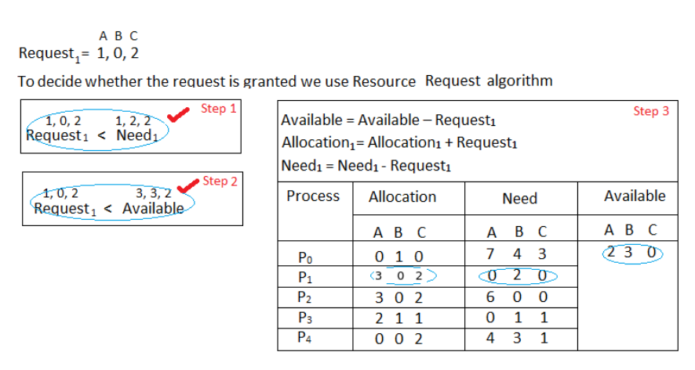
Banker's Algorithm
If process P1 requests one additional instance of resource type A and two instances of resource type C

Slide 17
THANK YOU

